Slide 1


BANK LOAN ANALYSIS
BY GROUP 1
SAIPRIYA
JEEVANA
FUAAD SANEEN
KARTHIKEYA
MOUNIKA

Slide 2

Project Objective
The project aim to analyze the Finance dataset of bank loan of customers, through a report to get insights from it by using different software tools such as Excel, MySQL, Tableau and Power Bi.
From these gained insights accurate business decisions are made.

Slide 3


Data set
Domain : Finance
Project : P434 Bank loan analysis of customers
Datasets : Finance_1.csv & Finance_2.xlsx
Dataset Type : Excel Data
Dataset Size: Each Excel file has 39k+ records

Slide 4





Data Analysis Process
Step 1
Define the Question
Step 2
Collect the data
Step 3
Clean the data
Step 4
Analyze the data
Step 5
Visualize and Share the Insights

Slide 5

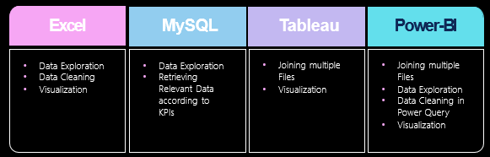



Tools used in the project

Slide 6

KEY PERFORMANCE INDICATOR
Year wise loan amount Stats
Grade and sub grade wise Revol_bal
Total Payment for Verified Status Vs Total Payment for Non Verified Status
State wise and month wise loan status
Home ownership Vs last payment date stats

Slide 7
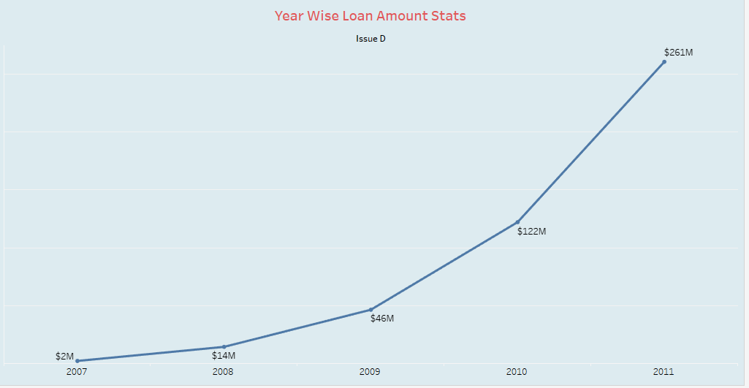
Year wise loan amount stats
The Loan amount is directly proportional with the increasing years.
It is continuously increasing by each year as you see it‘s varies from 2.0M to 261M between the years 2007 to 2011.
From the year 2009, The changes in loan amount is suddenly increased with a higher rate that is around 5 times higher rate for next 2 years as compared to previous 2 years.

Slide 8
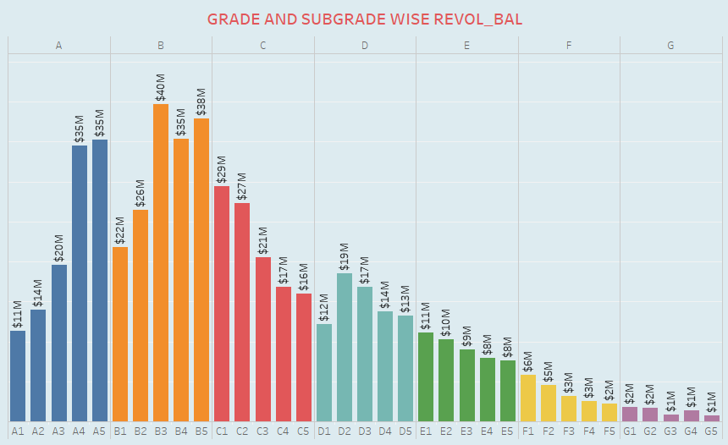
Grade subgrade wise revol_bal
There
There are 7 main grades and it‘s further consists of 5 sub-grades, It is shown by different colours in the representation from grade A to G.
The average revolving balance is higher in the grade “B3” that is “40M” and the lowest is in “G5” that is “1M”

Slide 9
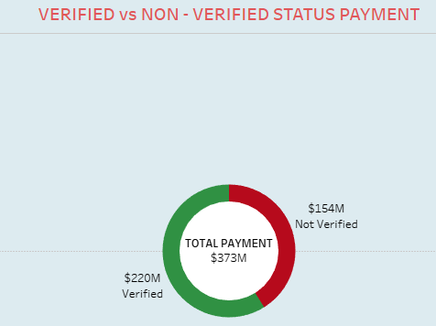
Total payments for verified status vs NON VERIFIED STATUS
The total payment for verified account is higher as compared to non-verified.
There are “220M” verified accounts and remaining “154” are non-verified.

Slide 10
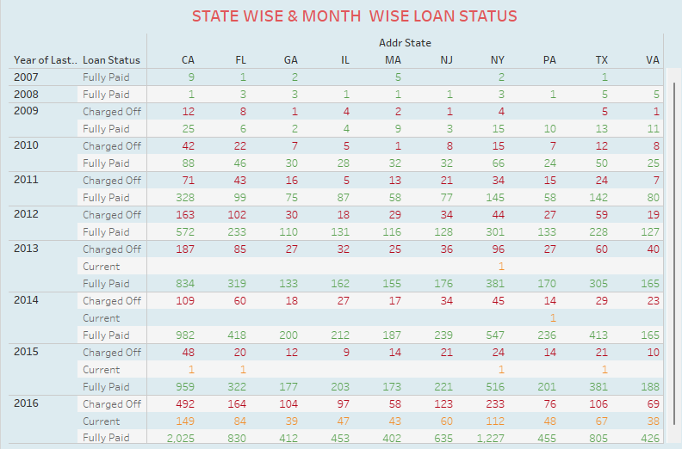
STATE WISE AND MONTH WISE LOAN STATUS
In the dataset we have 50 state, along with the 3 type of loan status. That is charged off, current and fully paid.
As you see from the representation, State ‘CA’ has the highest number of accounts in each type of loan status specially fully paid accounts. And state ‘ME’ has the lowest number of accounts in each type of loan status.
In the representation, Different colours of line shows the 3 type of loan status between the 12 months. That is red line indicates the charged off, orange line indicates the current and green line indicates the fully paid.
As you see the highest number of fully paid accounts is in the year of ‘2016’ that is $2025 and lowest is in the year of 2008 that is $1.
Same like this we can easily find the variations of number of accounts for other 2 type of loan status with the month wise.

Slide 11
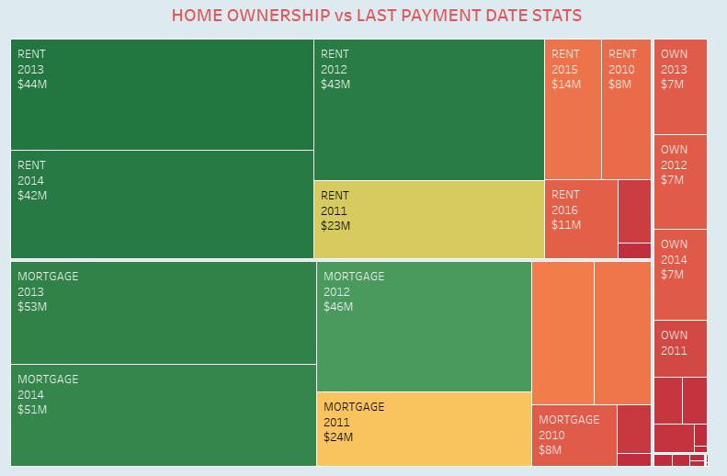
HOME OWNERSHIP VS LAST PAYMENT DATE STATS
Home ownership consists of the 3 types that is mortgage, own and rent indicted by different colours green, yellow and orange respectively.
In the tree map of representation, The type of amount of Home ownership varies from 2011 to 2016. And the maximum amount reaches in year 2012, That is around 46M. And the minimum amount is in 2011.

Slide 12
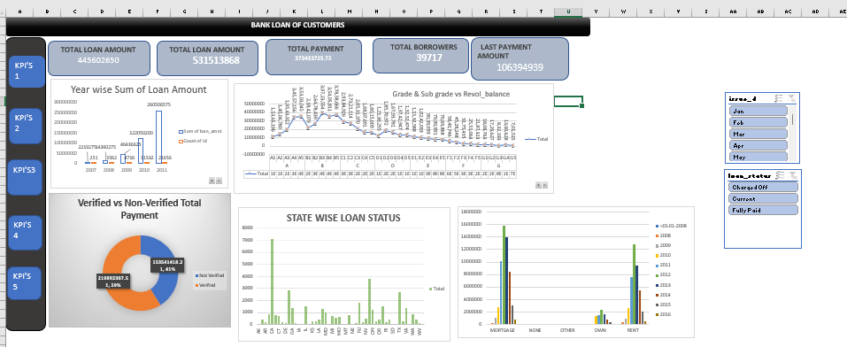
EXCEL
BANK LOAN ANALYSIS DASHBROAD

Slide 13
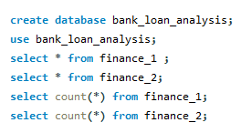
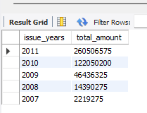
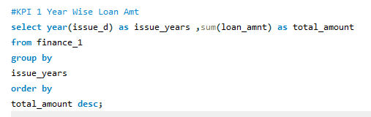

Slide 14
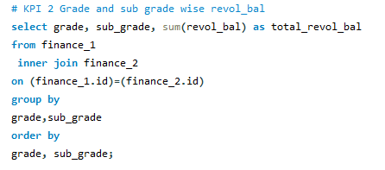
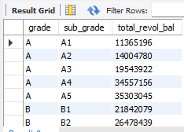
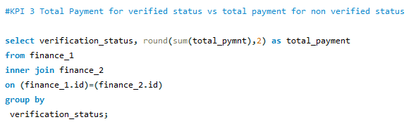
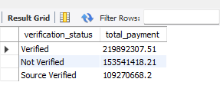

Slide 15
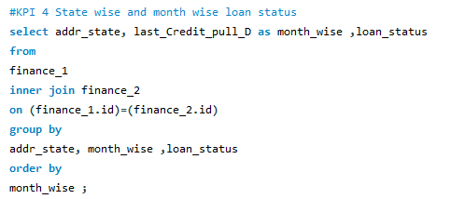
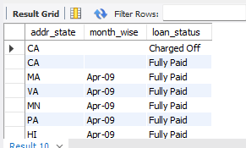
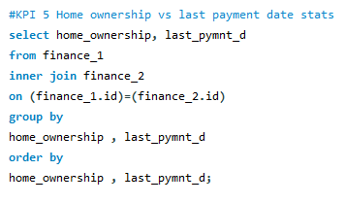
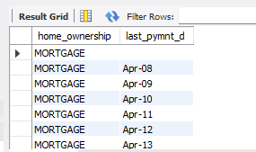

Slide 16
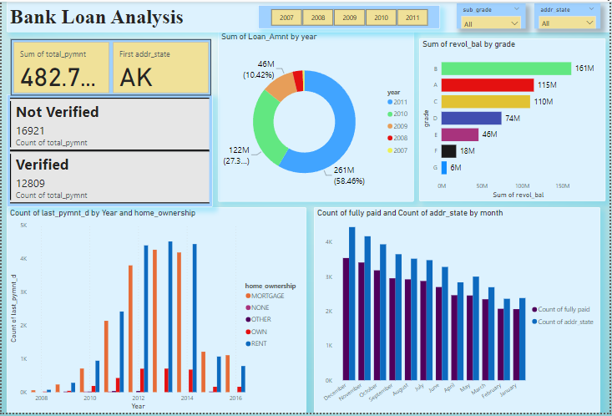
BANK LOAN ANALYSIS DASHBROAD

Slide 17
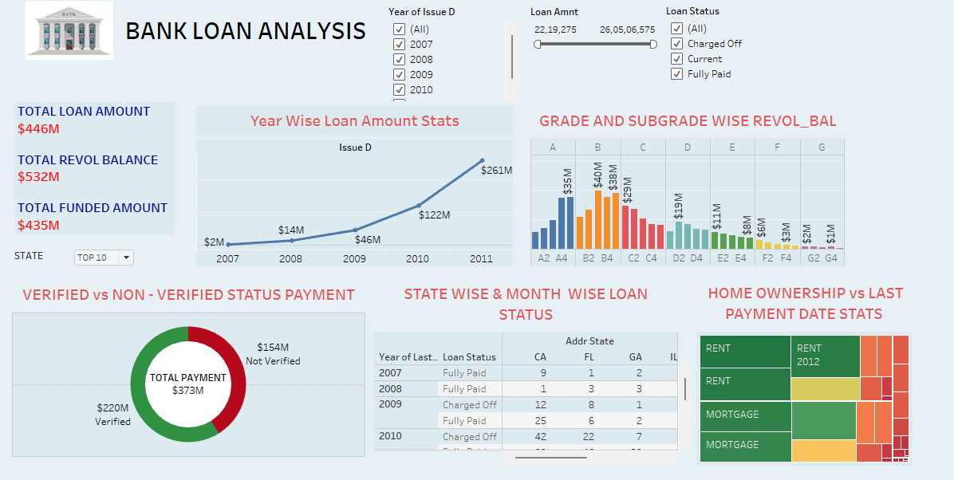
BANK LOAN ANALYSIS DASHBROAD

Slide 18
CONCLUSION
Banking holds a crucial role in our day-to-day life. From the analysis of above dashboards and reports we can draw hidden insights. With the use of gained insights from the finance datasets and KPI'S. Accurate Business decisions are made and can track the business state. It enables a holistic view of the business , supporting long-term growth and competitiveness in the banking industry.

Slide 19
Recommendation
Diversify loan portfolio across sectors/types for risk mitigation.
Provide personalized support to borrowers in current status for timely payments.
Encourage responsible credit utilization to minimize revolving balances across all loan grades.
Provide personalized support to borrowers in current status for timely payments.
Support resources for managing financial responsibilities of homeowners with outright ownership.
Provide education and resources to borrowers to promote responsible payment behavior across all verification statuses.

Slide 20
THANK YOU

